Slide 1

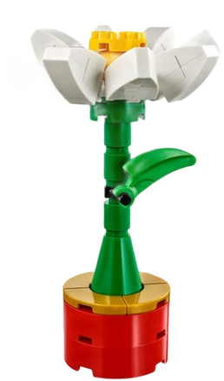
Flower Image Synthesis – DCGAN
Ankur, Haitham, Rodolfo – 2020 Deep learning (University of Toronto)

Slide 2
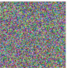
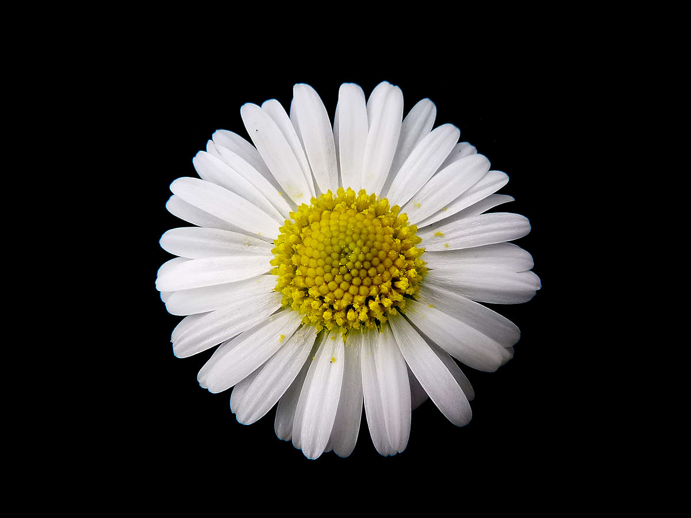
Problem Statement
To generate flowers from an input of a noise matrix which is trained on a set of flower images using the GAN’s (Generative Adversarial Network).
Possible Applications :
Generate artwork
Image Synthesis
# of flowers
Input
Output
Z
GAN

Slide 3
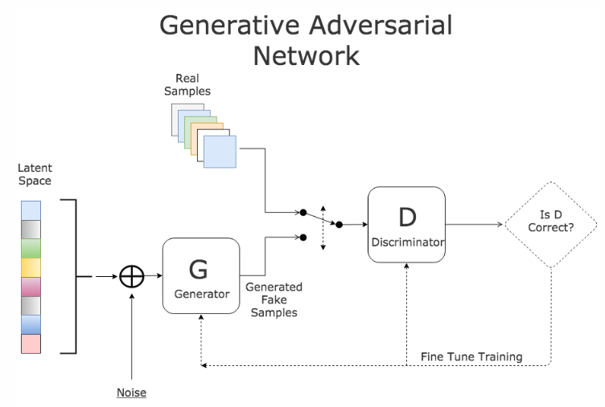
BACKGROUND - GAN
GAN is based on the approach of training 2 different networks
Generator Network : Tries to generate realistic looking – samples
Discriminator Network : Tries to figure out whether an image came from the training set or the generator network.
Objective : The generator tries to fool the discriminator network in order to predict that the image came from training set ( when in reality was generated by Generator)

Slide 4
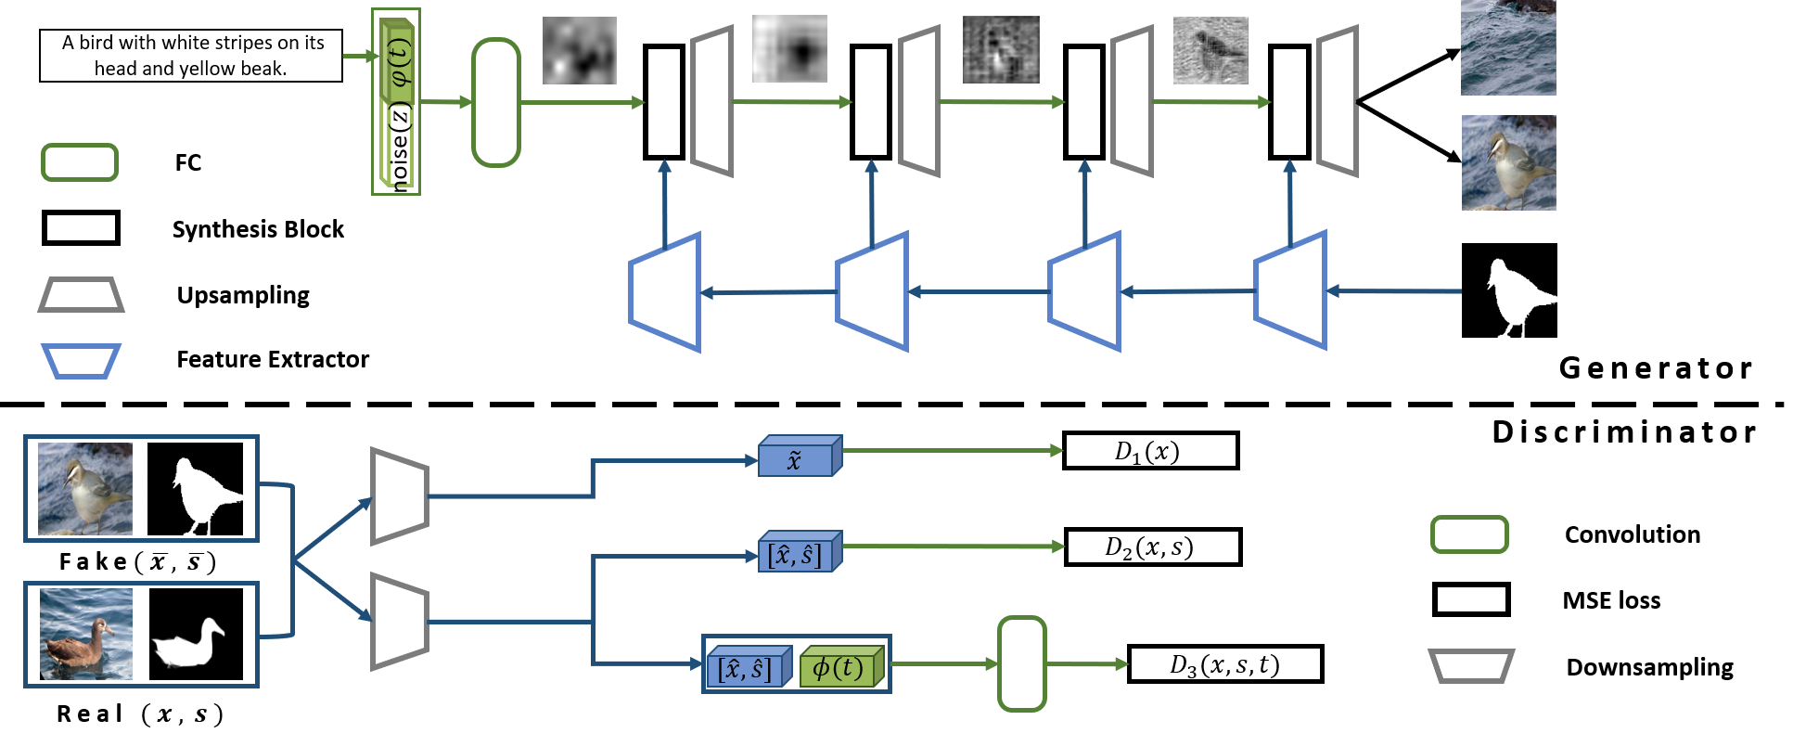
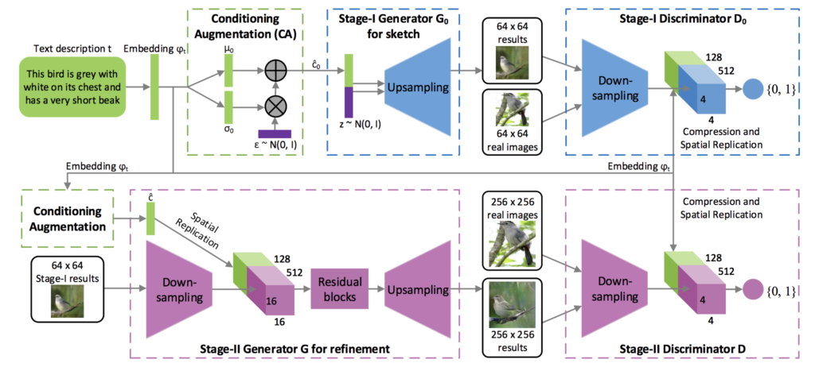
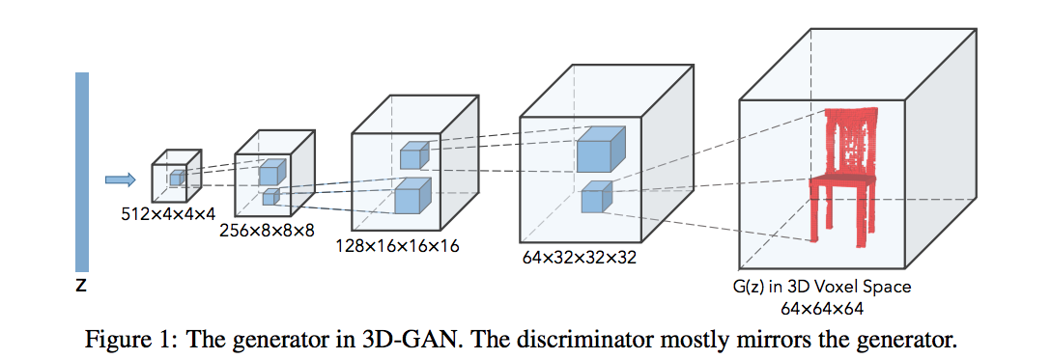
Different GAN’s
MC – GAN – Used for image generation from text
attributes
Stack GAN – Used for Text to image synthesis
3D GAN – Generation of 3D object from images

Slide 5
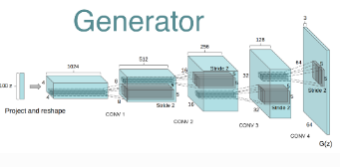
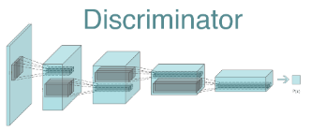
DCGAN Network
DCGAN came into existence because CNN networks were not able to scale up the image generation process.
Core approach (3 changes to CNN architecture):
All convolution net functions. ( convolution stride and transposed convolution for the down-sampling and the up-sampling)
No fully connected layer or max pooling layers
Batch Normalization : Stabilizes learning by normalizing the input to each unit to have zero mean and unit variance. (no batch normalization for output layer in generation and input layer in discriminator)
Additional notes
a. Use ReLU activation in generator for all layers except for the output, which uses Tanh.
b. Use LeakyReLU activation in the discriminator for all layers.

Slide 6


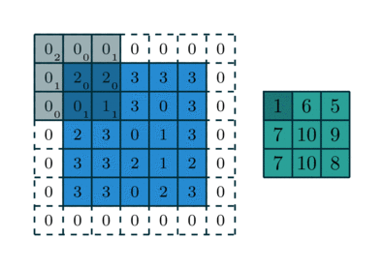
Strides / Padding
No – Padding / 1- Stride
1 – Padding / 1- Stride
Padding : The amount of pixels added to an image when it is being processed by the kernel of a CNN.
Stride : It is the number of pixels shifts over the input matrix. The value controls how the filter convolves around the input volume.
By default, the filter convolves around the input volume by shifting one unit at a time.
1 – Padding / 2- Stride

Slide 7
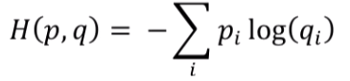
Loss Function
Loss Function : Discriminator in GAN uses a cross entropy loss, since discriminators job is to classify; cross entropy loss is the best one out there.
Below formula represents the cross entropy loss between p: the true distribution and q: the estimated distribution.
The intention of the loss function is to push the predictions of the real image towards 1 and the fake images to 0. We do so by log probability term.
In GAN, discriminator is a binary classifier. It needs to classify either the data is real or fake

Slide 8
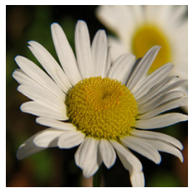
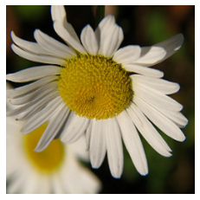
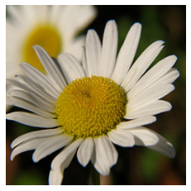
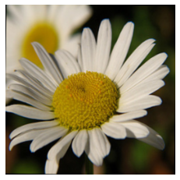
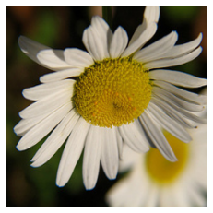
Image Data Pre-Processing
Resizing pictures to 256x256 pixels.
Image Normalization : Convert from 256 to 0 to 1.
Data augmentation techniques were used to increase the no. of images required for training the dataset.
Horizontal Flip Image
Vertical Flip Image
Random Rotation Image
Horizontal and Vertical Flip Image
Original Image

Slide 9
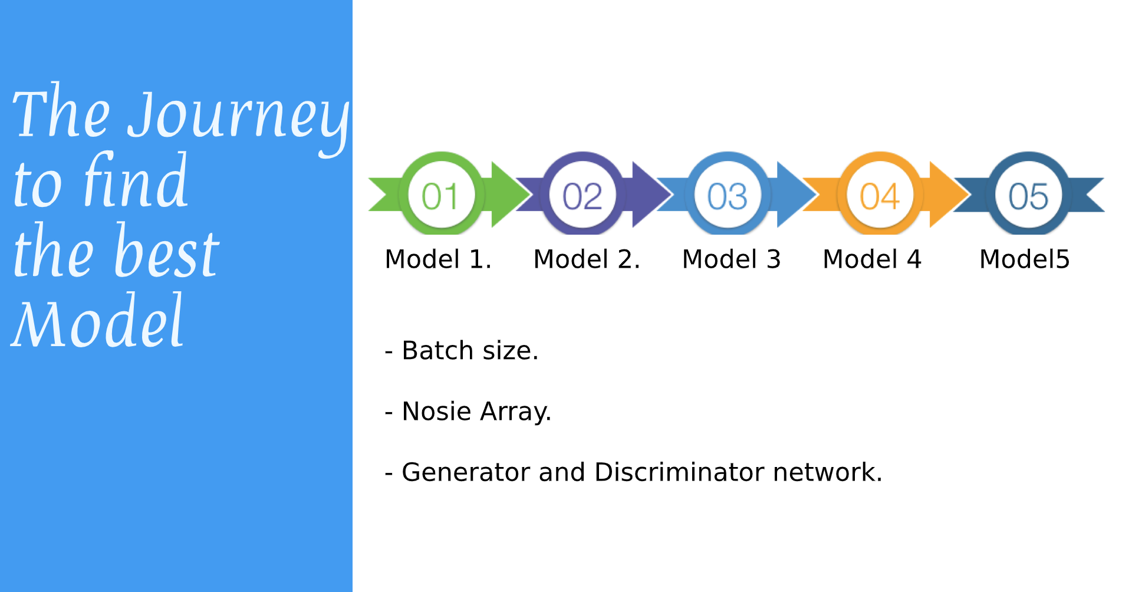
Journey
- Generator and Discriminator network.
- Generator and Discriminator network. - Generator and Discriminator network.

Slide 10

Model Enhancement Journey

Slide 11
Model Comparisons
S.No. | Model Name | Batch size | Noise Array | Generator | Discriminator | LR_D | LR_G | Comments
1 | Model 1 | 64 | 100 | Initial Shape : 8,8,512 Layers : 6 Conv2D Transpose Layers | Layers: 5 Conv2D Layers | 0.0001 | 0.0001
2 | Model 2 | 64 | 100 | Initial Shape : 64, 64,256 Layers : 3 Conv2D Transpose Layer | Layers: 2 Conv2D Layers | 0.0001 | 0.0001
3 | Model 3 | 64 | 1000 | Initial Shape : 8,8,512 Layers : 6 Conv2D Transpose Layers | Layers: 5 Conv2D Layers | 0.0001 | 0.0001
4 | Model 4 | 64 | 100 | Initial Shape : 64, 64,256 Layers : 3 Conv2D Transpose Layer | Layers: 2 Conv2D Layers | 0.0002 | 0.0002 | Use batchnorm in both the generator and the discriminator. Use ReLU activation in generator for all layers except for the output, which uses Tanh. Use LeakyReLU activation in the discriminator for all layers.
5 | Model 5 | 128 | 100 | Initial Shape : 16, 16,1024 Layers : 4 Conv2D Transpose Layer | Layers: 3 Conv2D Layers | 0.0002 | 0.0002
6 | Model 6 | 64 | 100 | Initial Shape : 32, 32,512 Layers : 3 Conv2D Transpose Layer | Layers: 2 Conv2D Layers | 0.0002 | 0.0002

Slide 12
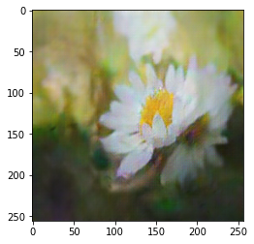
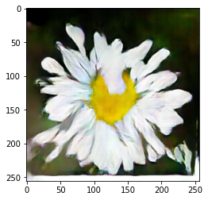
How to Evaluate gan’S
GAN’s lack an objective function, which makes it difficult to compare performance of different models.
Options:
Manual inspection of generated images.
Qualitative evaluation.
Quantitative evaluation.
Which one is better?

Slide 13



Future Work
Train with different species of flowers
Translation of style
generate cross species flowers
day to night
black and white pictures to color pictures
Measuring the accuracy with Quantitative Evaluation methods combined with Qualitative Evaluation instead of Manual Inspection

Slide 14
Recommendations
Recommended platform for running GAN code/dataset/checkpoints.
Google Colab Pro
Connected for up to 24h instead 12h
Priority to high-memory VMs with twice CPUs
Faster GPUs
Problem with Session connection for long training
Colab Pro with Google Drive for storing checkpoints
The easiest setup
Google Cloud AI Platform Notebooks with GPU
Slower than Colab Pro
Colab Pro with Google Clould Bucket for storage was the fastest and more efficient method. (Best combination)

Slide 15
Project Details
Project on GitHub:
https://github.com/ravasconcelos/flowers_dcgan
YouTube:
https://www.youtube.com/watch?v=0uTfwXIWl40

Slide 16
References
Deep Convolutional Generative Adversarial Network
https://www.tensorflow.org/tutorials/generative/dcgan
Flowers Recognition Kaggle Dataset
https://www.kaggle.com/alxmamaev/flowers-recognition
How to Evaluate Generative Adversarial Networks
https://machinelearningmastery.com/how-to-evaluate-generative-adversarial-networks/
Unsupervised Representation Learning With Deep Convolutional Generative Adversarial Networks
https://arxiv.org/pdf/1511.06434.pdf%C3%AF%C2%BC%E2%80%B0

Slide 17
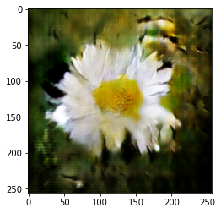
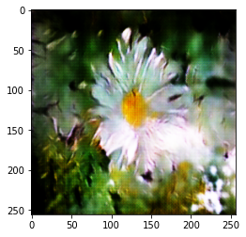
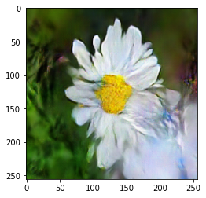
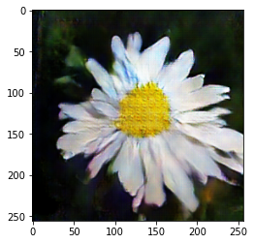
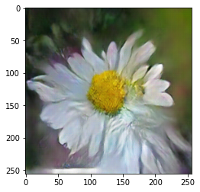
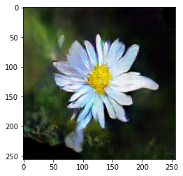
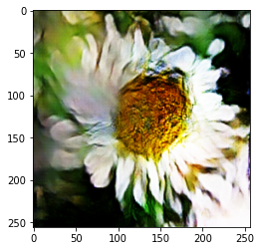
Some generated flowers

